Slide 1



> dotnet tour|
Scott Addie
Senior Content Developer
@Scott_Addie

Slide 2
Agenda
CLI overview
Frequently used commands
VS Code integration
VSTS integration
Template creation

Slide 3



What is the .NET Core CLI?
Chassis on which tooling is built
Makes command line 1st class citizen
Works everywhere
Side-by-side installs
Notes:
- C:\Program Files\dotnet\sdk

Slide 4


Learn abstraction below comfort zone
Visual Studio
Visual Studio Code
Visual Studio for Mac
.NET Core CLI
Notes:
Not all commands accounted for in tooling:
dotnet store (create runtime store)
dotnet publish (SCD) ← coming in VS 2017 15.7 Preview 3
Compare to GitHub for Windows vs. Git command line

Slide 5
Command structure
dotnet command [<arguments>] [<options>]
dotnet publish my_app.csproj -c Release
Notes:
- dotnet my_app.dll ← only case when dotnet is used w/o command

Slide 6
DEMO
Frequently used commands

Slide 7
Integration with VS Code
Consistent experience on all platforms
Extensions:
C# (OmniSharp)
Azure CLI Tools
Use with…
Command Palette
Integrated Terminal
Tasks

Slide 8

VS Code DEMO

Slide 9
Integration with VSTS
CI / CD pipeline
Build definitions
Release definitions
CLI knowledge needed for advanced cases
Notes:
Also applies to TFS
If using IDE / editor, you wouldn’t know the CLI params to pass

Slide 10

VSTS DEMO
Notes:
- scottaddie.visualstudio.com > TagHelperSuite build definition

Slide 11
Creation of templates
Create .template.config folder
Define metadata in template.json
Create .nuspec file
nuget pack <path_to_nuspec>
dotnet new -i <path_to_nupkg>
Notes:
works for project & item templates
NuGet steps optional if doing file system / network share installation
SideWaffle Template Creator extension for VS 2017 ← add templates to VS

Slide 12
DEMO
Template creation

Slide 13

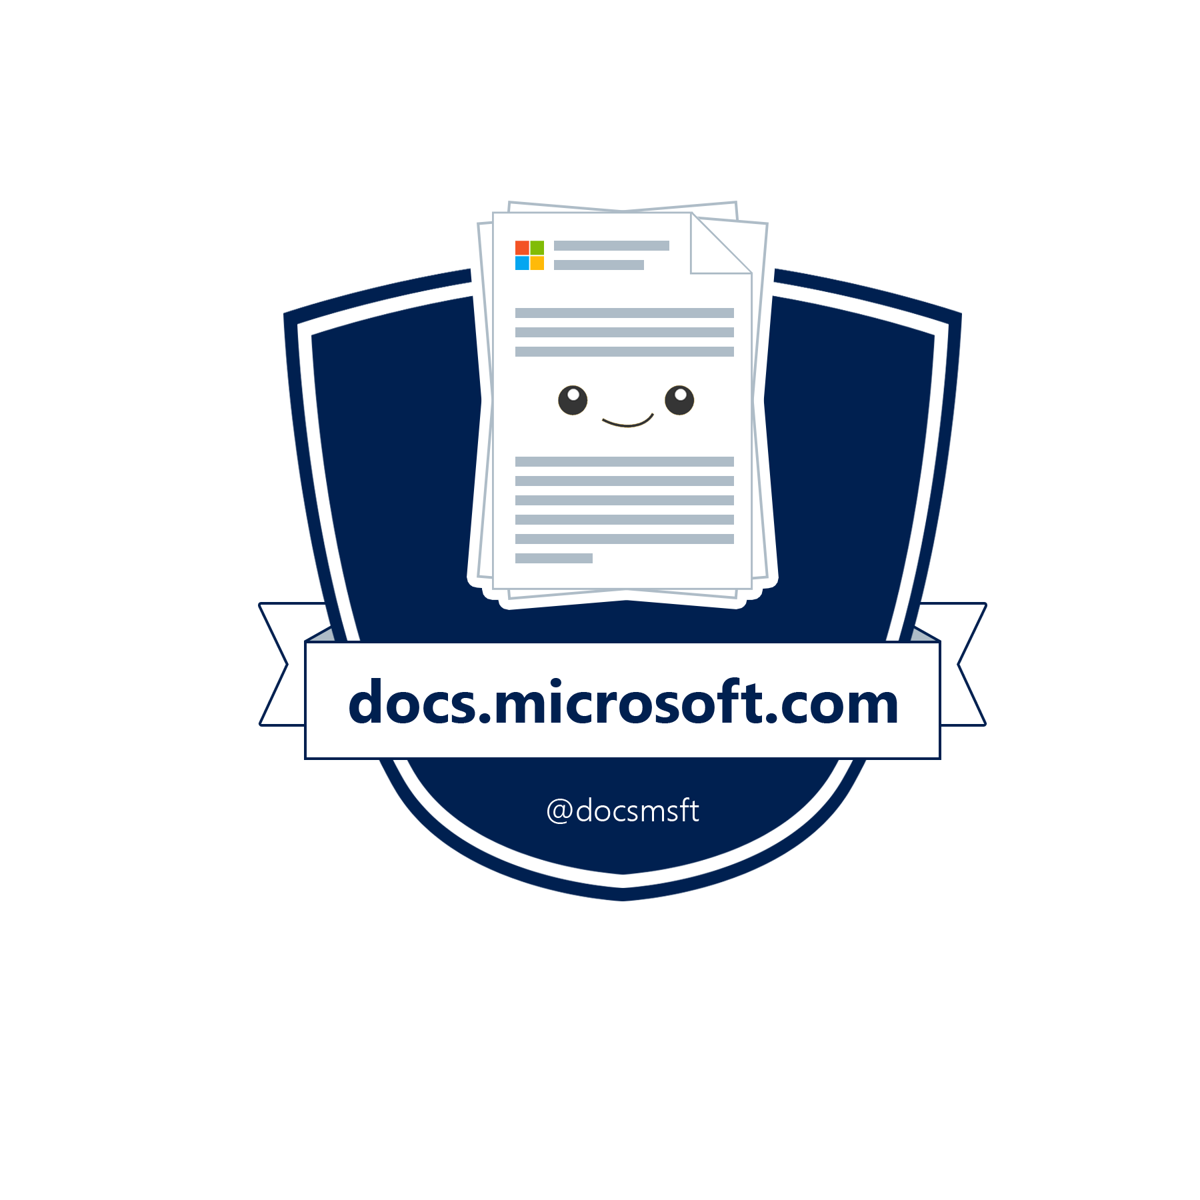

Build with Microsoft Tech
Explore developer tools, platforms, and APIs

Slide 14
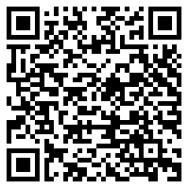

Thank you!
aka.ms/N44not
docs.microsoft.com/dotnet/core/tools
@Scott_Addie

